Slide 1
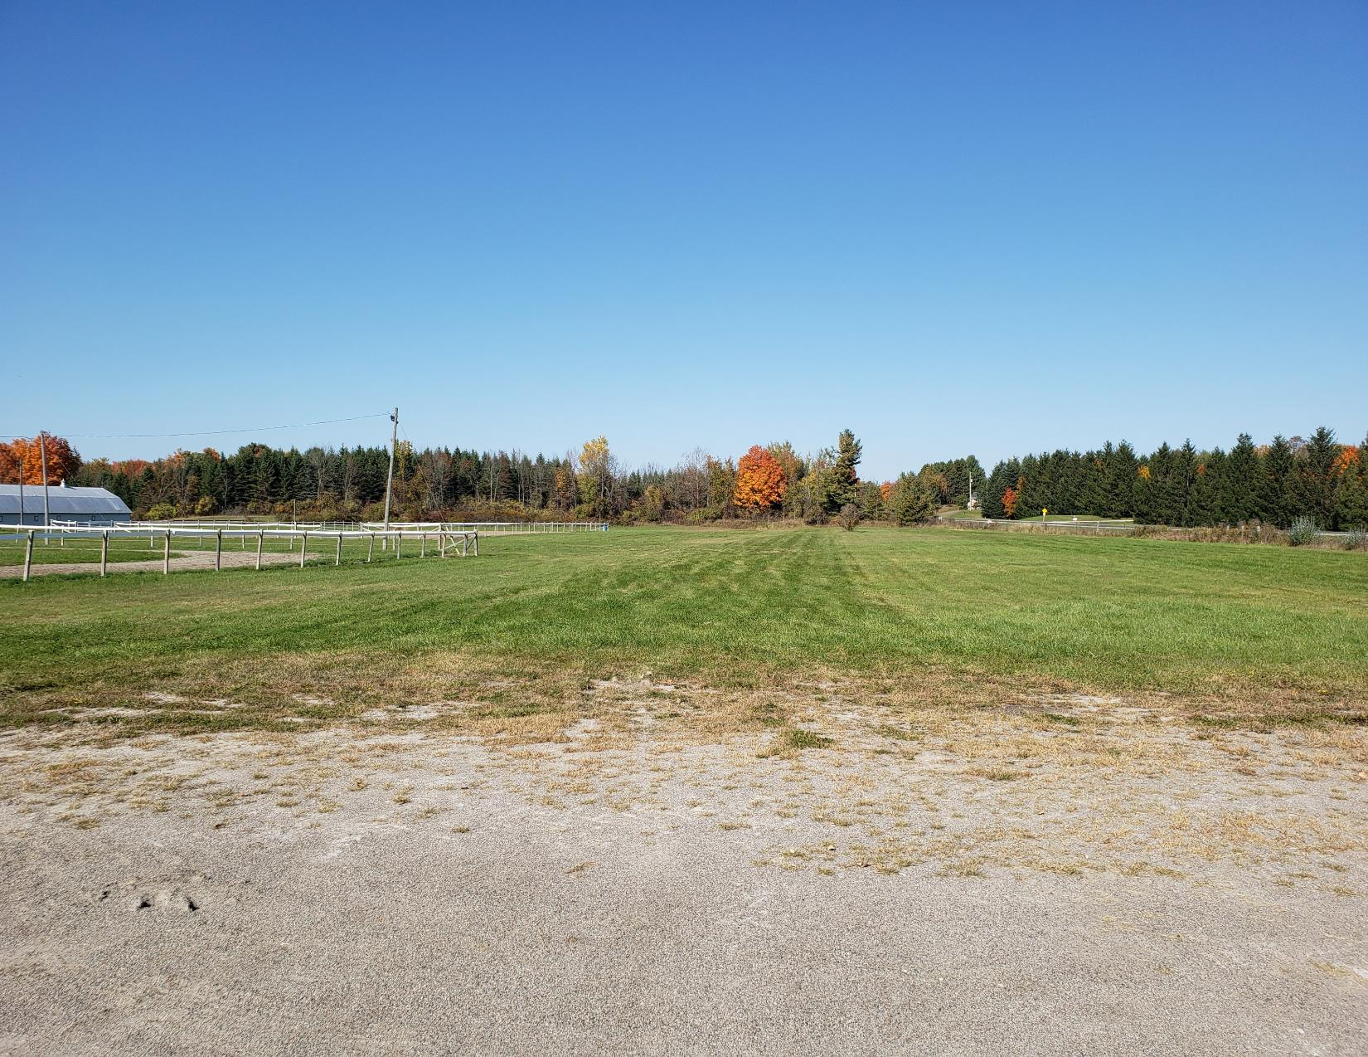

MUNICIPALITY OF CENTRE HASTINGS
PARKS, RECREATION & CULTURE MASTER PLAN
User Group Workshop: November 28, 2022
1

Slide 2
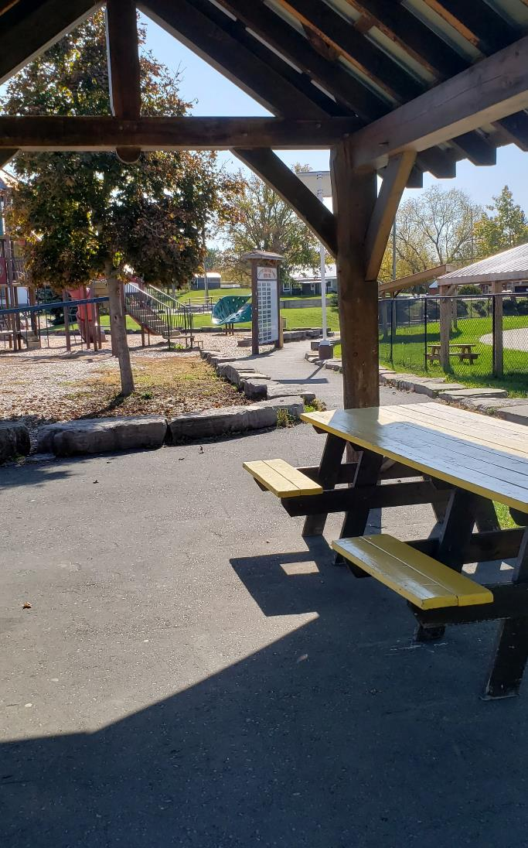
User Group Workshop Agenda
1. Welcome and Introductions 5.30 – 5.35 pm
2. Presentation 5.35 – 5.50 pm
3. Questions? 5.50 – 6.00 pm
4. Discussion 6.00 – 6.50 pm
5. Wrap-Up & Next Steps 6.50 – 7.00 pm
2

Slide 3
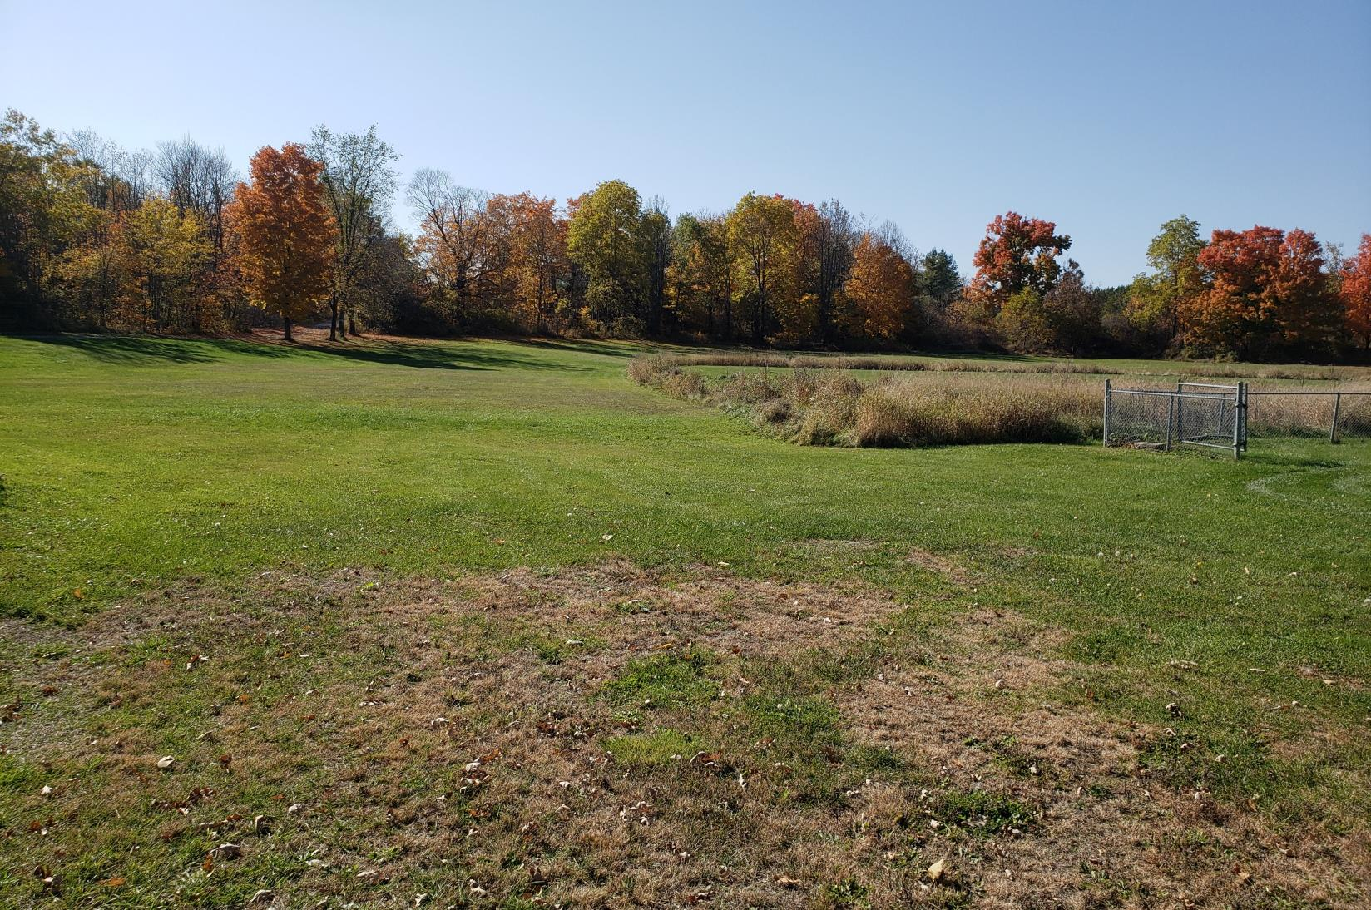

Team Introduction
Recreation Facilities
Programming
Service Delivery
Financials
Implementation
3

Slide 4
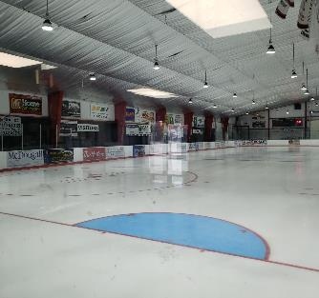
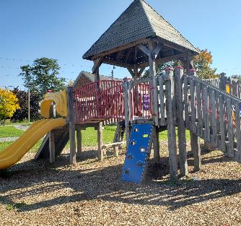
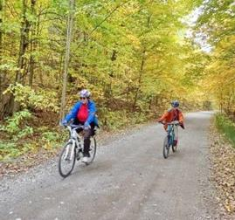
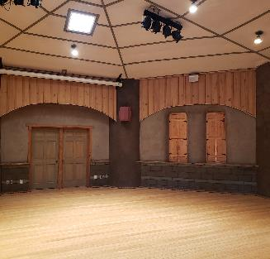
Master Plan Scope
Indoor Recreation Facilities
Arena, town halls
Park Facilities
Park amenities, sport fields, open spaces
Trail Facilities
Culture Facilities
Art Centre
4

Slide 5
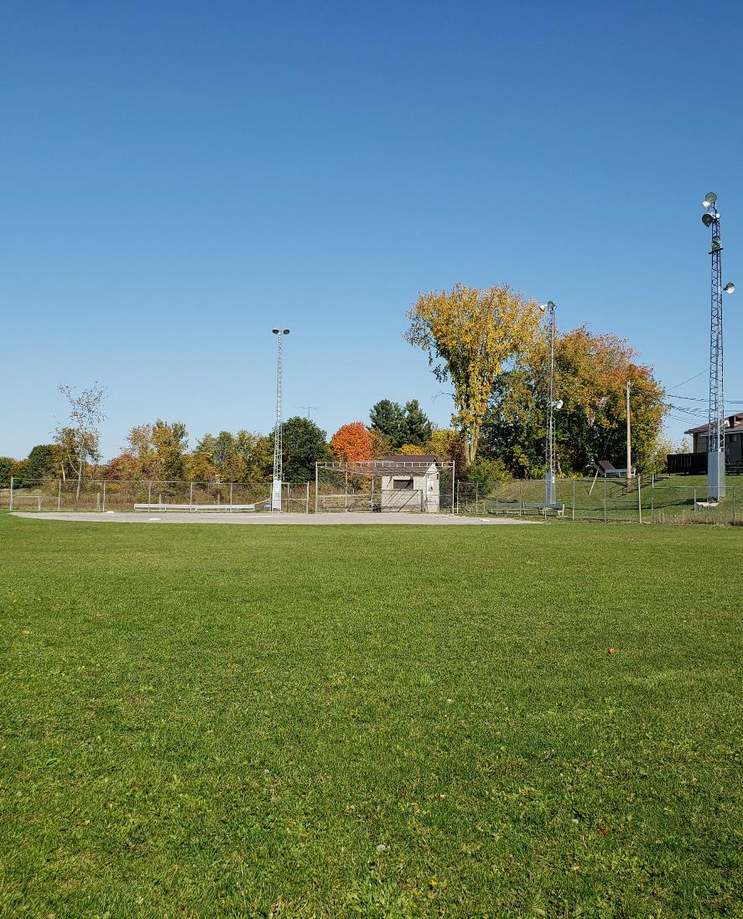
Objectives
The Master Plan will guide municipal planning for parks, recreation and culture facilities and programming for the next 10 years.
KEY OBJECTIVES
Harness the community vision for future parks, recreation, and culture;
Identify trends and best practice;
Identify and assess the diverse needs and desires of the residents;
Identify the optimal configuration and management of multi-use green spaces;
Identify improvements to facility bookings; and
Create a prioritized implementation plan for capital investment.
5

Slide 6
Work Plan
Phase 1: Background and Context
Project Start-Up (October 20, 2022)
Phase 2: Community Consultation
Inventory Review
Phase 3: Strategic Directions
Develop Recommendations
Data Collection, Research & Analysis
Presentation to Council
Phase 4: Implementation Plan
Needs Analysis (ongoing)
Stakeholder Consultation
Develop Options/ Directions
Staff Review
Draft Master Plan
Implementation Framework
Master Plan Finalization
Community Consultation
October – November 2022
November 2022 – January 2023
December 2022
January – February 2023
6

Slide 7
Consultation Details
Community Consultation
External Stakeholder Consultation
Internal Stakeholder Consultation
Online presence and social media
Community workshop (January 2023)
Public online survey (closed on November 23, 158 responses)
External stakeholder interviews (November 2022)
Town staff from variety of departments (i.e. finance, planning, recreation, etc.)
User Group Meeting (November 28 – by invitation only)
User Group online survey (closes December 15)
November 2022
November - December 2022
October 2022 – January 2023
7

Slide 8
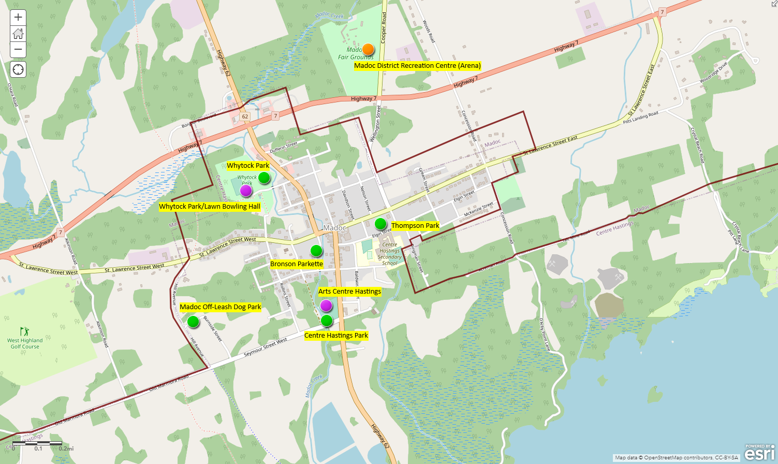
Situational Analysis: Settlement Area Inventory
 | Amenities
Municipal Outdoor Facilities | Soccer Field | Softball Diamond | Skate Park | Tennis Court | Beach Volleyball | Outdoor Fitness | Playground | Splash Pad | Outdoor Pool | Off-Leash Dog park | Boat Launch
Centre Hastings Park |  |  | 1 |  |  |  | 1 | 1
Huntingdon Park |  | 1 |  |  |  |  | 1
Thomson Park |  |  |  | 2 |  |  | 1
Whytock Park | 1 |  |  |  | 3 |  |  |  | 1
Bronson Parkette |  |  |  |  |  | 1
Trinity Parkette
Madoc Off-LeashDog Park |  |  |  |  |  |  |  |  |  | 1
Moira Lake Boat Launch |  |  |  |  |  |  |  |  |  |  | 1
8

Slide 9
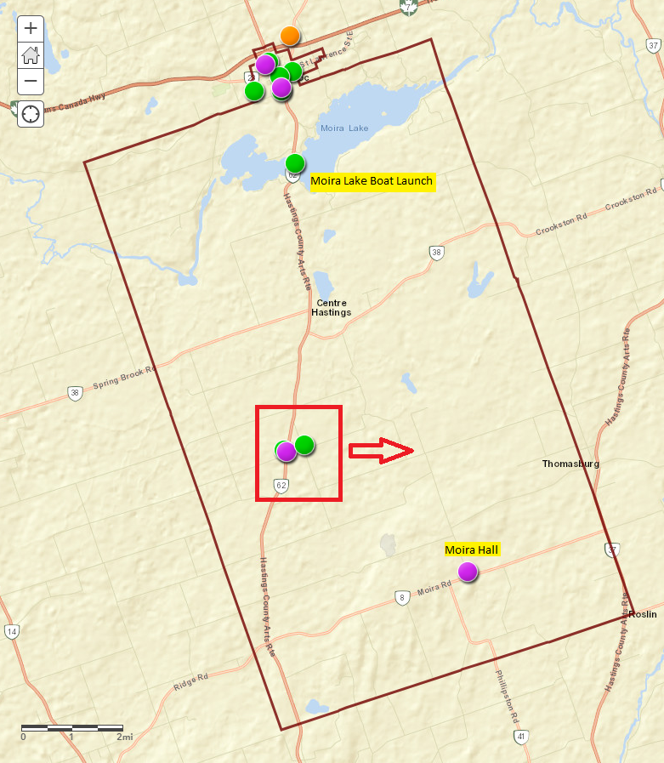
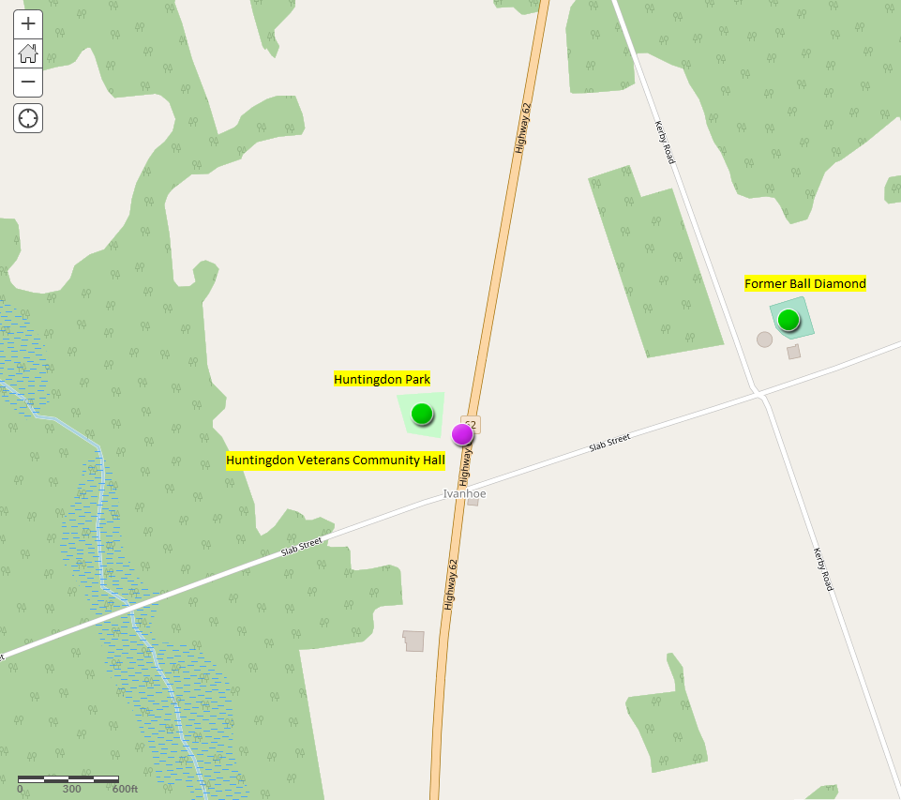
Situational Analysis: Rural Inventory
9

Slide 10
Discussion Questions
What’s your view of the Municipality’s parks and recreation facilities?
    What should be celebrated?
    What needs to be changed or enhanced?
    Overall level of satisfaction (i.e., Do the facilities meet the needs of your group?)
What challenges exist for your group, and what solutions have you sought?
Does your group use facilities outside of Centre Hastings? If so, where and why?
What are you hearing from your members about what they’d like to see in the future?
Are there examples from other communities that you think would be relevant that Centre Hastings could learn from related to parks, recreation and culture?
10

Slide 11
Thank You!

